Slide 1
The Charlatan: Financial Update
AGM 2020-2021

Slide 2
HELLO!
The name’s Qureshi, Maaz Qureshi.
Treasurer @ The Charlatan since June 2019
4th YR Business Finance Student
Fellow Netflix Binger

Slide 3
Looking To The Past
1
A Quick 2019-2020 Financial Review

Slide 4
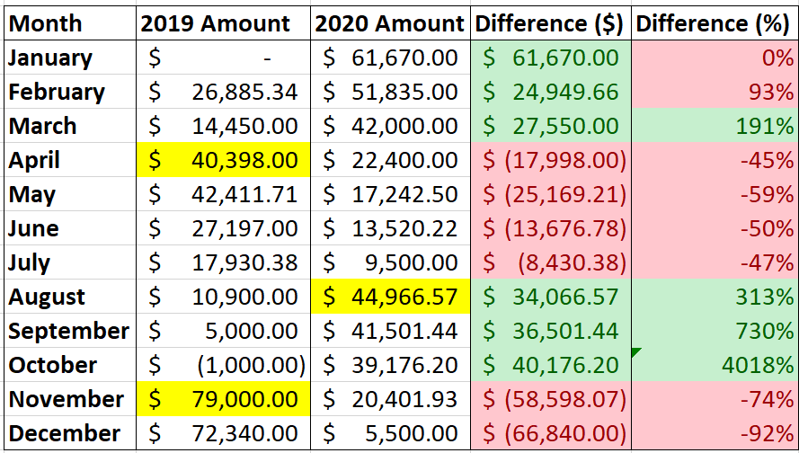
NUMBERS!
2019 vs 2020
Yellow => Levy Deposited
Worth pointing out:
May 2020 - July 2020 is only < 0 because we did not deposit the levy until Aug 2020.
4018% only exists since there was a negative balance in Oct 2019.
Nov 2020 - Dec 2020 is only < 0 since we received the levy late due to COVID-19.
Notes:
Overall, gains in 2020 improved as compared to 2019’s.

Slide 5
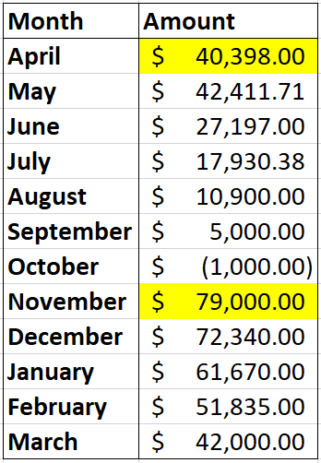
MORE
NUMBERS!
FY 2020
Yellow => Levy Deposited
FY => Fiscal Year
Starts on This Year’s April (2019)
Ends on Next Year’s March (2020)
Pre-COVID:
Get Winter Levy in April
Get Fall Levy in November
During COVID:
Levies came 1-3 months later
Notes:
Overall, gains in 2020 improved as compared to 2019’s.

Slide 6
Back To The Present
2
2020-2021 Financial Review

Slide 7
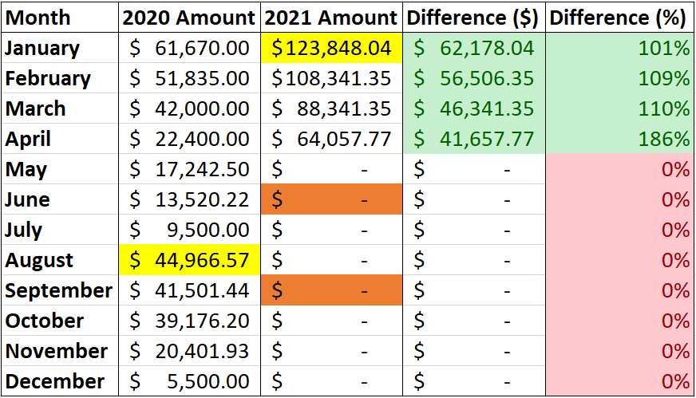
EVEN MORE
NUMBERS!
2020 vs 2021
Yellow => Levy Deposited
Orange => Levy Expected
Worth pointing out:
$ difference is higher since we had a higher fall levy than expected - $124,039.31
% difference on the rise since lower expenses and printing costs.
Winter Levy to be expected by May/June.
Fall Levy to be expected by August/September.
Assuming CU has had time to adapt to new COVID changes.
Notes:
Overall, gains in 2020 improved as compared to 2019’s.

Slide 8
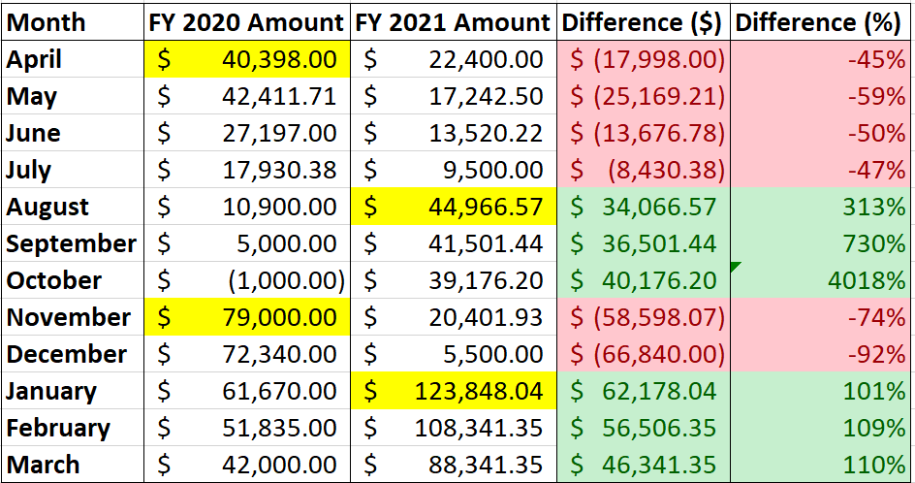
EVEN MORE
NUMBERS!
AGAIN
FY 2020 vs FY 2021
Yellow => Levy Deposited
FY => Fiscal Year
Starts on This Year’s April (2020)
Ends on Next Year’s March (2021)
Levies were not deposited at the same time, hence the difference.
Notes:
Overall, gains in 2020 improved as compared to 2019’s.

Slide 9
The Main Event
3
The Charlatan 2021/2022 (AKA FY 2022) Budget

Slide 10
CREATING THE FY 2022 BUDGET
Studied the FY 2021 Budget
Looked at the Expenses & Revenue Changes in FY 2021
Compared the Two & Created 2 FY 2022 Budgets
Fully Online Budget
In-Person Budget

Slide 11
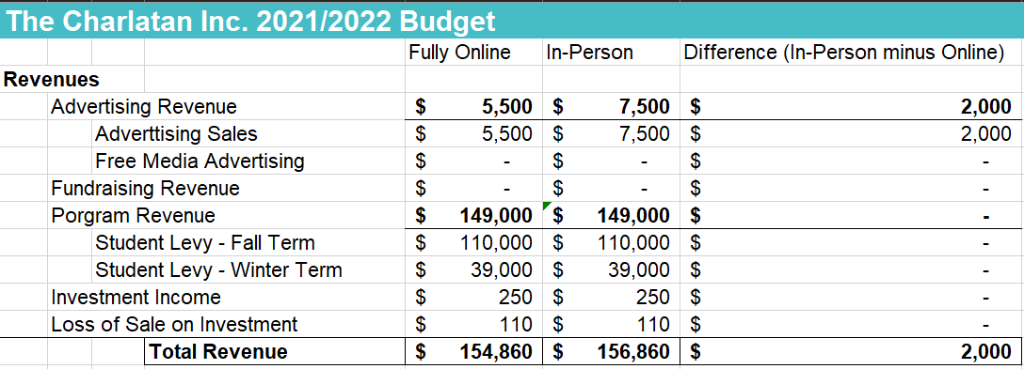
Revenue
The Levies are both estimates.

Slide 12
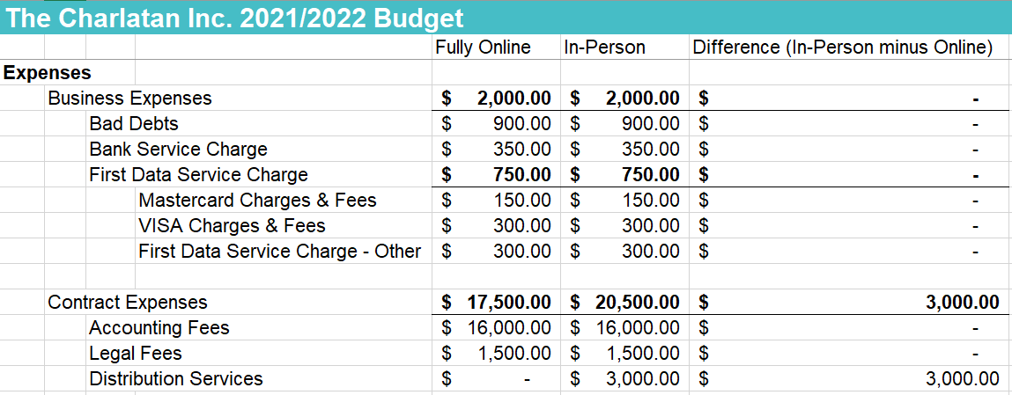
Expenses - Business & Contract

Slide 13
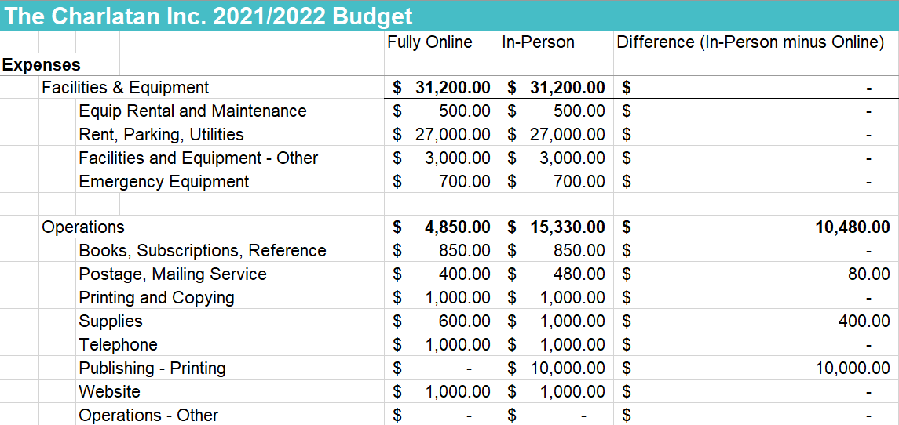
Expenses - Facilities & Equipment and Operations

Slide 14
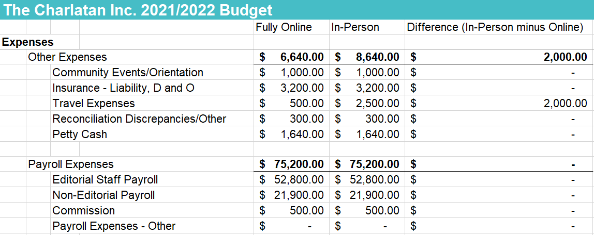
Expenses - Other & Payroll

Slide 15
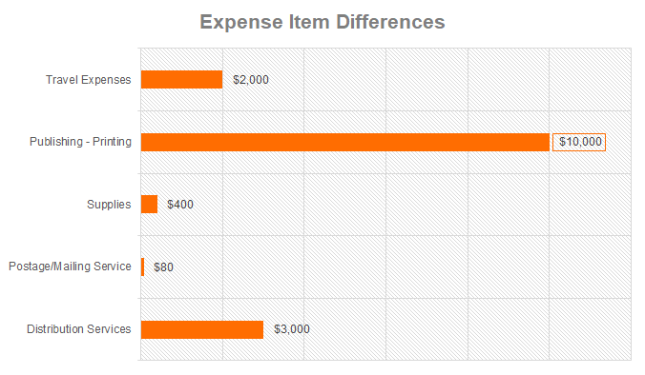

Slide 16
Overall Summary
Total | Fully Online | In-Person | Difference
Revenue | $154,860 | $156,860 | $2,000
Expenses | $137,390 | $152,870 | $15,480
Surplus | $17,470 | $3,990 | $(13,480)
Positive Cash Flow either way. Online proves to be least expensive approach.
Switching from Online to In-Person will cost ≈ $13,480

Slide 17
THANKS!
Hope this helped!
Feel free to ask any questions :)

